Slide 1

Step Counter

Slide 2
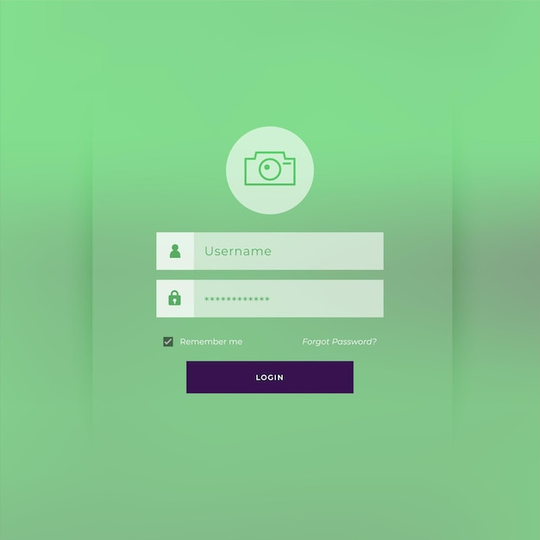
LOGIN

Slide 3


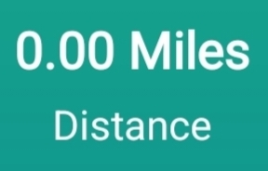

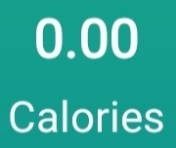

8 Hours 36 Minutes till next day
0
Goal:10 000

Slide 4







Settings Goal : 10000

Slide 5

Turn Off For
15 MINUTES
30 MINUTES
1 HOUR
2 HOUR
4 HOUR

Slide 6


History

Slide 7
Thank You
Give Feedback

